Slide 1
MITIGATING API SECURITY THREATS
Presentation by Saiganesh Angadi
October - 2024

Slide 2
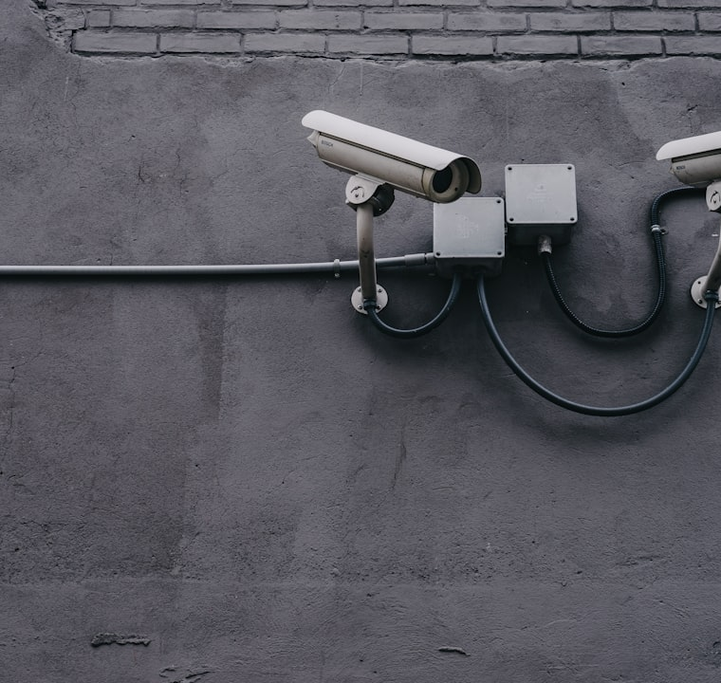
Understanding API Threats
Common API Threats
APIs face various threats like SQL injection, Cross-Site Scripting (XSS), and Distributed Denial of Service (DDoS) attacks. Understanding these threats is key to effective defense.

Slide 3


Best Practices Overview
Employee Training
Training developers on security best practices is crucial. A well-informed team can identify and mitigate security issues early in the development lifecycle.
Security Frameworks
Utilizing established security frameworks like OWASP can reduce vulnerabilities. Regular audits and compliance checks bolster your security posture.

Slide 4
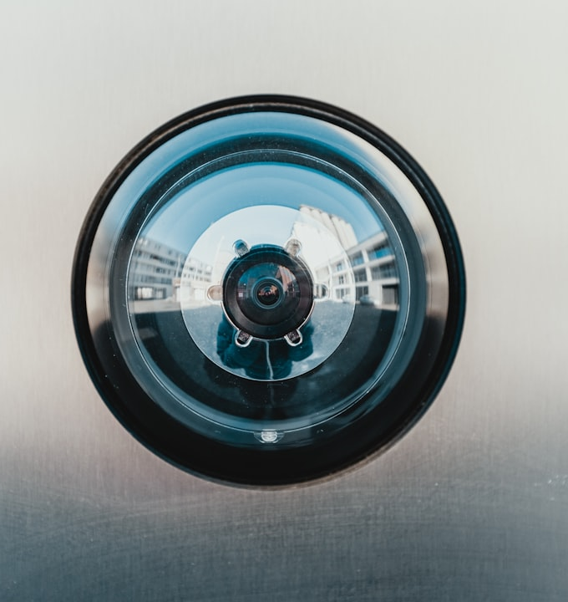
Threat Prevention Techniques
Rate Limiting
API Gateways
Limit the number of requests made by users to mitigate DDoS attacks. Implementing rate limiting can protect resources from being overwhelmed.
Utilize API gateways to manage traffic. These can provide security features such as authentication and encryption automatically.
Sanitize Inputs
Always sanitize user inputs to prevent injection attacks. Use libraries that help in validating data properly before processing.

Slide 5
Security Measures Table
Security Measure | Description | Importance
Rate Limiting | Controls the number of requests | Prevents overload
Authentication Methods | Different levels of user verification | Stronger defense
Data Encryption | Secures data in transit and at rest | Protects sensitive information
Logging and Monitoring | Tracks API usage and anomalies | Aids in incident response
Vulnerability Assessments | Regular checks for weaknesses | Ensures ongoing security diligence

Slide 6
Statistical Insights
40%
30%
20%
10%
Frequent issues
Major cause of concern
Constant threat
Emerging risk
Data breaches account for 40% of security incidents, showcasing a need for stringent data protection.
Misconfigurations lead to 30% of breaches, stressing the need for proper security settings.
Hacking attempts comprise 20% of incidents, emphasizing ongoing vigilance and security.
Malware attacks are on the rise, accounting for 10% of incidents, indicating emerging threats.

Slide 7

Future Considerations
Trends in API Security
Future trends in API security will focus on AI-driven security solutions, increased automation, and enhanced encryption methods. Staying updated is essential.

